Slide 1


Business as a Leaving Certificate Subject

Slide 2

Why study Business?
Leaving Certificate Business creates an awareness of the importance of business activity and develops a positive and ethical attitude towards enterprise.
You will develop important skills such as critical thinking, creative and organisational skills while enhancing literacy and numeracy skills using real-life examples.

Slide 3
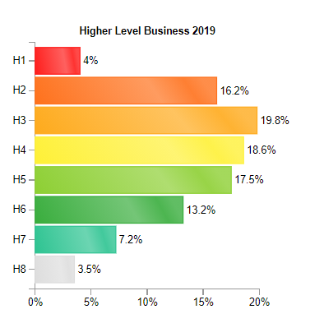
Leaving Certificate Business – 2019 Statistics

Slide 4
Exam Structure
The subject is examined at higher and ordinary level.
Final Exam = 100%
3 hour exam
  3 sections.
    Section 1 – Short questions (answer 8 out of 10) 80 marks.
    Section 2 – Applied Business Question – 80 marks (compulsory).
    Section 3 – Long Questions (60 marks per question (answer 4 out of 7)

Slide 5
Business as a subject
Of the 3 leaving cert subjects, it is the one with the most theory (very little number work or calculations)
A hard working student has a great opportunity to achieve in this subject.
Business is a great subject as it the foundation for many business related courses at college e.g. Finance, Human Resources, accounting, management
It is a very relevant and topical course. Students enjoy the common sense and real life content of the course.

Slide 6
Summary
Business is a practical course that introduces students to the world of business in a straightforward and logical way.
The course sets out to illustrate the process of setting up a business and developing a new product or service. It emphasises the importance of good management and with the impact of technology, foreign trade, global firms and competition also looking at business structures and the national economy.
Business requires students to stay alert and to be aware of current related business media (e.g. newspapers, TV, radio). The course is theory based and therefore requires a lot of learning.

Slide 7
Who is suitable for Business?
It is not essential to have completed JC Business, but it is an advantage. Being a hard worker is key as it has quite a lot of theory – but fun theory!
Students who have a keen interest in current affairs.
Business is useful for students that are thinking about careers in areas including Banking, Finance, Administration, Law, Insurance, Management and Marketing among others.

Slide 8


Business and numbers
More theory than numbers.
Some tax calculations and ratio analysis.
Drawing graphs and analysing graphs and data is important in a couple of chapters.

Slide 9
Course Content
The core units include:
Introduction to people in business;
Enterprise;
Management 1 & 2;
Business in action;
Domestic Environment
International Environment.
There is a common syllabus covering Higher and Ordinary level, which will fulfil the aims and objectives of the course.

Slide 10

Careers
The Leaving Cert Business programme provides a fantastic foundation for careers in Banking, Finnace, Administration, Law, Insurance, Management and Marketing

Slide 11

Business Teachers at LC
Helen Stack,
Jim Dempsey and
Sinéad McGouran

